Slide 1
Quick Review: What properties of a landscape can vary?

Slide 2
Quick Review: What properties of a landscape can vary?
Composition
Fragmentation
Aggregation
Connectivity
Shape complexity
Edge density
…….

Slide 3
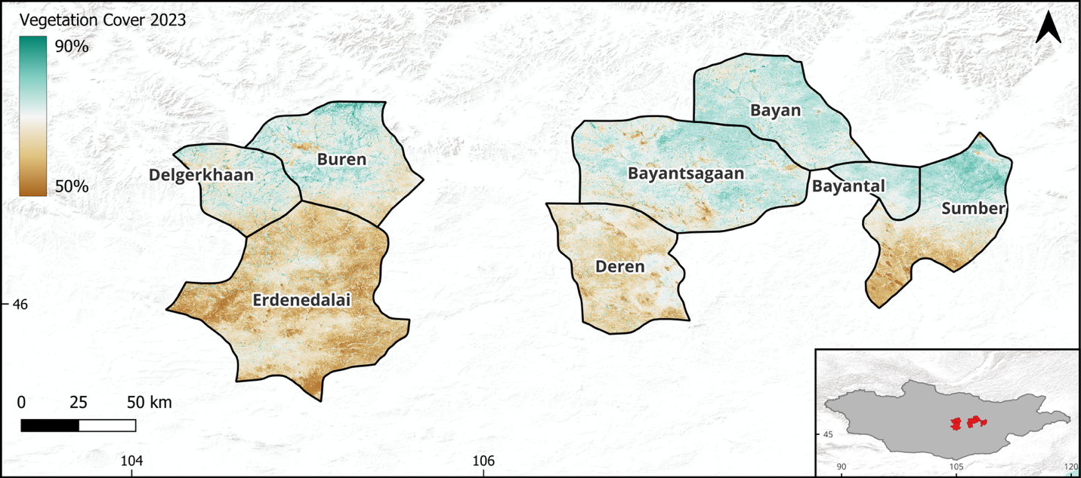

Slide 4
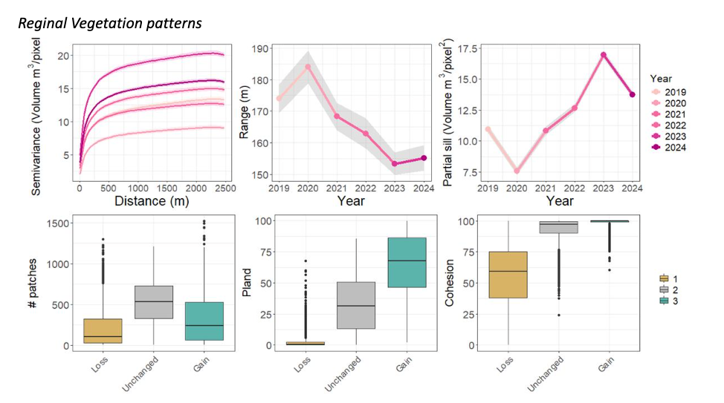

Slide 5
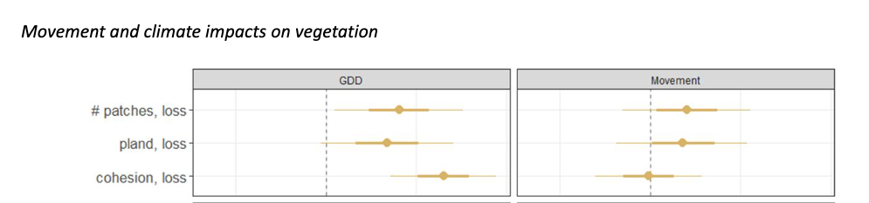
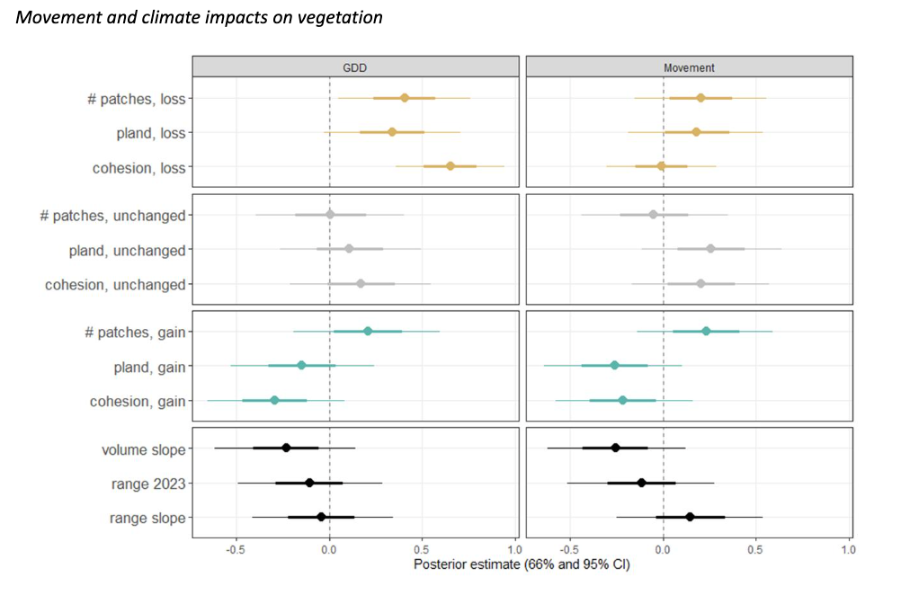

Slide 6
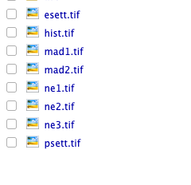
Folder setup:
/Landscape_Metrics_Lab
Lab3.Rproj
Lab3_student_script.R
/data
/
Early Settlement
Post Settlement
Madison 1
Madison 2
Northeast 1
Northeast 2
Northeast 3

Slide 7
Parameters to specify :
Grain size
Neighbor rule
Scale of analysis:
  Patch
  Class
  Landscape

Slide 8

https://r-spatialecology.github.io/landscapemetrics/

Slide 9
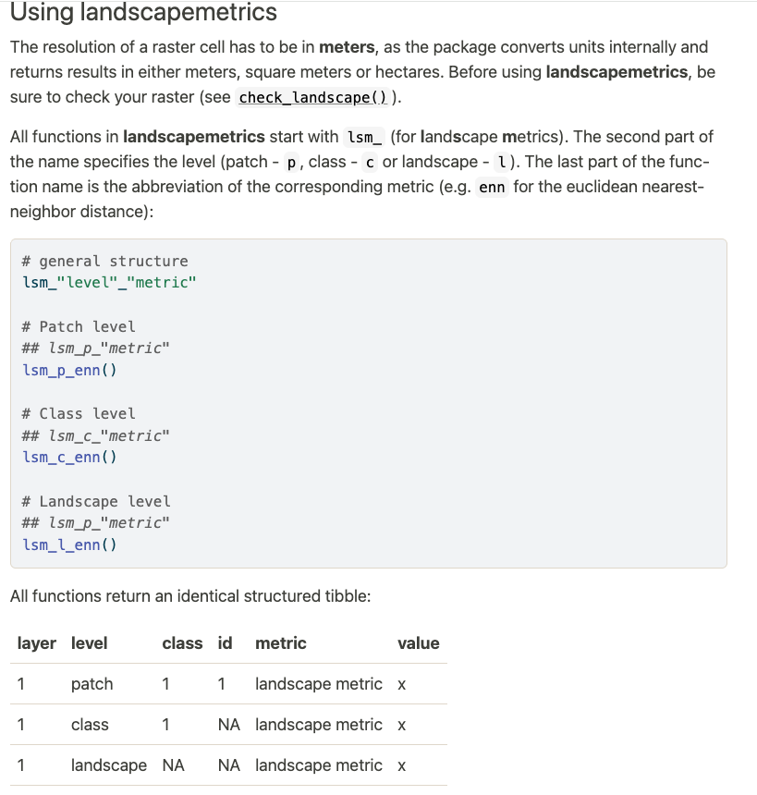

Slide 10
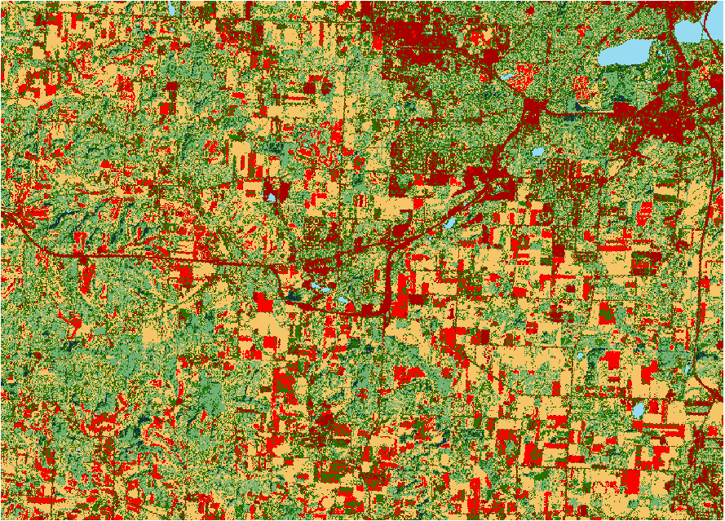
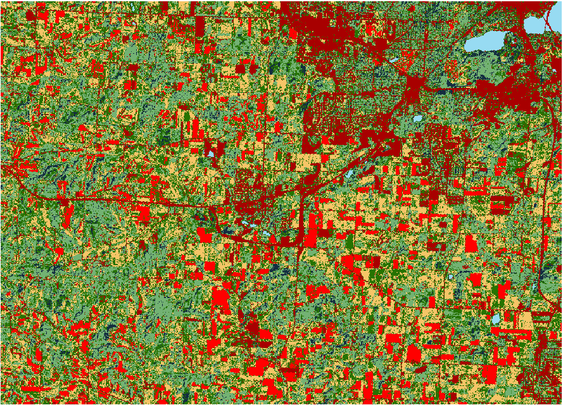
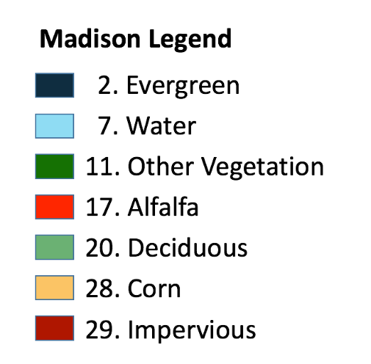
Madison 1 Madison 2

Slide 11
